Slide 1
Online Sport Store
Ultimate
3 Persons
Toleu Meirlan, Madiyar Zhumabekov, Kipchakpayev Madiyar

Slide 2
Requirements:
Title page (IT logo, full project name, team members' names)
Project description (concept, scope, value proposition)
Market research (SWOT analysis, composition of market and GTM)
UX research (customer surveys and interviews, fail case)
Roadmap and testings (tables and screenshots)
Software requirements specification (at least 2 diagrams, software used)
MVP (Figma prototype screenshots, features and functions)

Slide 3
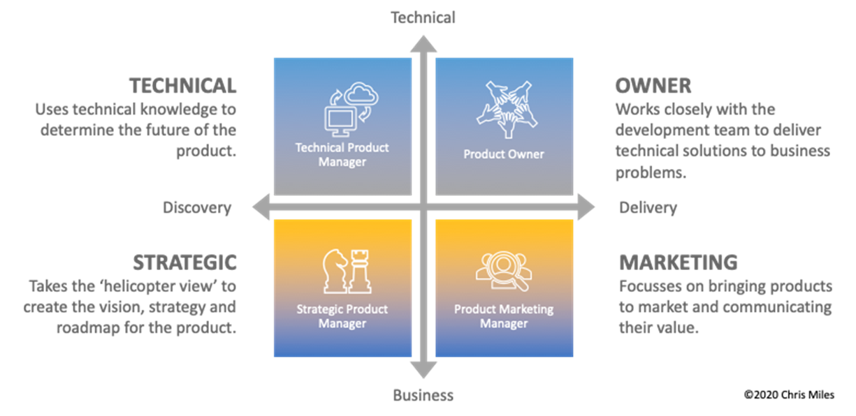
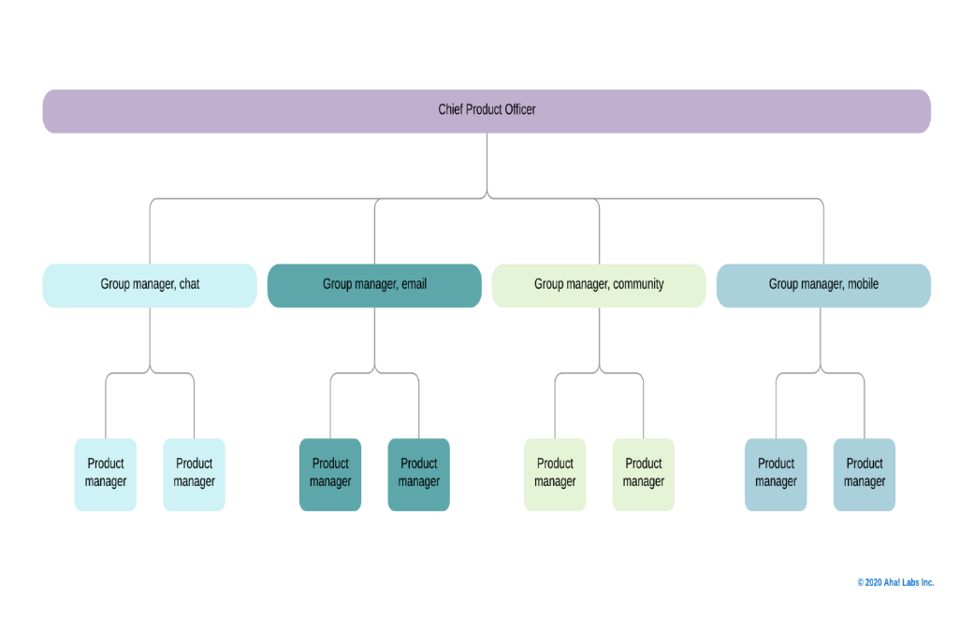
IDEA
When it comes to product management, the job title is actually very vague. Most of the times, you’ll find a job posting looking for a „Product Manager“, senior or junior. If you’re lucky, it is expanded by an additional keyword.
While Marketing positions often give away their specific role in the title – like SEO Manager, Social Media Manager, E-Mail-Marketing specialist, etc. – the product manager role is often just named as that, a Product Manager
Managing sports products – from planning to sales – is a complex job full of responsibility. The product manager shoulders the corporate responsibility to lead each product to success. Truly excellent managers are rare and in demand in this industry.

Slide 4
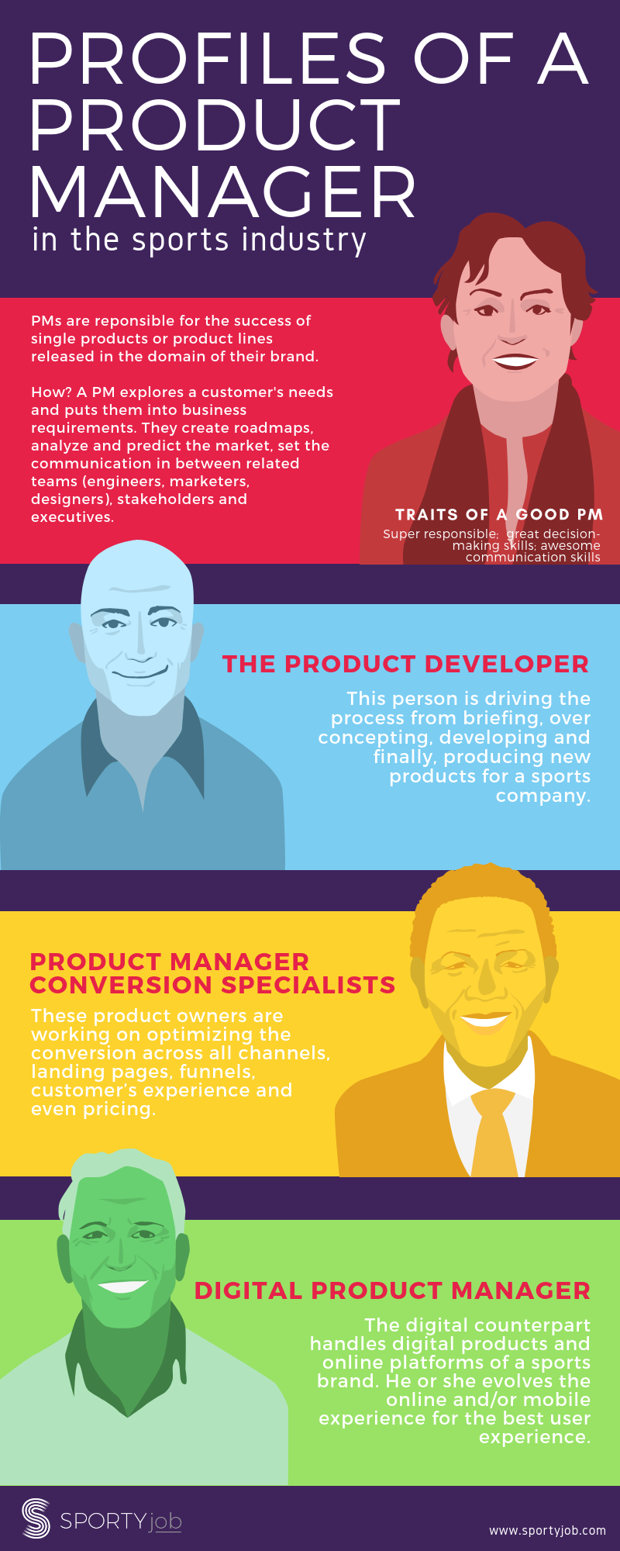
In the sports industry, product owners or managers aim for success for products or product lines released in the domain of a brand. They develop strategies to please the customer’s needs in order to optimize a product or its communication and conversion. They create roadmaps, analyze and predict the market, set the communication in between the different related teams (engineers, marketers, designers), stakeholders and executives.

Slide 5
Сoncept

Slide 6

We started our career in graphic design working for a local sports company. During my time there, I saw a lot of great things and worked with many awesome people. However, I also noticed that their use of technology, or lack thereof, is making them fall behind with regards to gaining more business.

Slide 7
Stakeholder goals
Stakeholders should be able to order their equipment and customize and preview their garments as well as set up online shops for their students in an efficient manner. Having prices for screen printing and embroidery, previewing the designs, and being able to put in your custom orders online are missing from the current website. Having these elements would drive up business.

Slide 8
UX Problems
There are a few main challenges foreseen in implementing these changes. The first is that the owner is technology averse and does not see the need to change what she’s been doing for the past 25+ years. Paper-based orders and invoices are still being used, so the margin for error increases, the time spent filling out orders increases, and the ability for a customer to have the ordering in his/her own hands is not present at all.

Slide 9
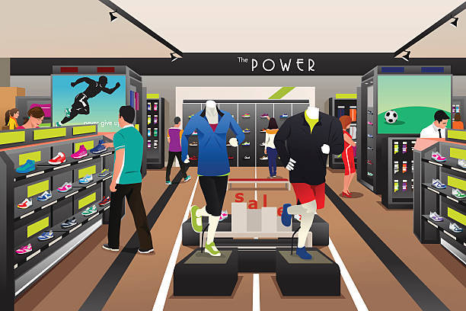
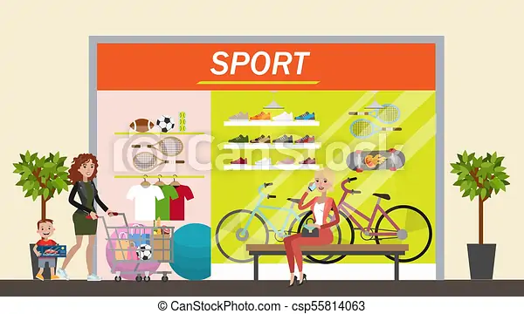
Customers are not getting the level of service that they want.
A customer should be able to choose between ordering online, ordering with help from a staff member online, ordering on the phone, or in-person. Implementing changes would decrease the degree of difficulty, and much time would be saved for everyone. Switching to online ordering would improve the business flow and would garner more business from users who are used to doing everything online.

Slide 10
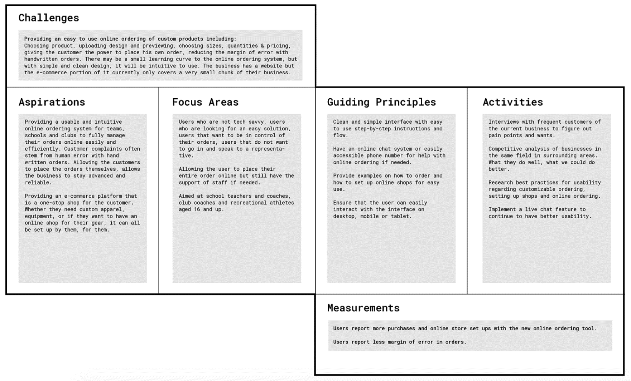
Info
Workplace: Personal Project
Services: UX
Year: 2018
Role: Research
Duration: 3 months
Environment: Solo
UX Research

Slide 11
Name
Demographics | Masters degree in education High school head of the physical education department
Home & Family Life | Married 3 teenagers Coaches competitive basketball in his spare time Has a single-family home and 2 cars
Proficiency and Comfort Level | Comfortable with online ordering Coaches using his iPad
Quote | I want to get equipment and athletic apparel for my school and club programs at competitive prices from a trusted online retailer.

Slide 12
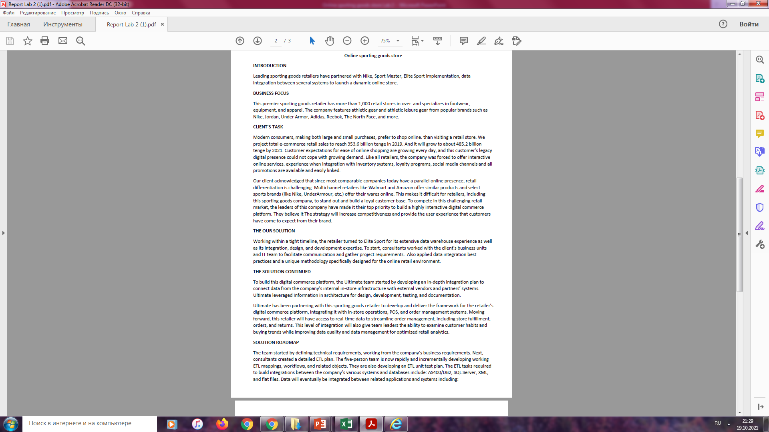
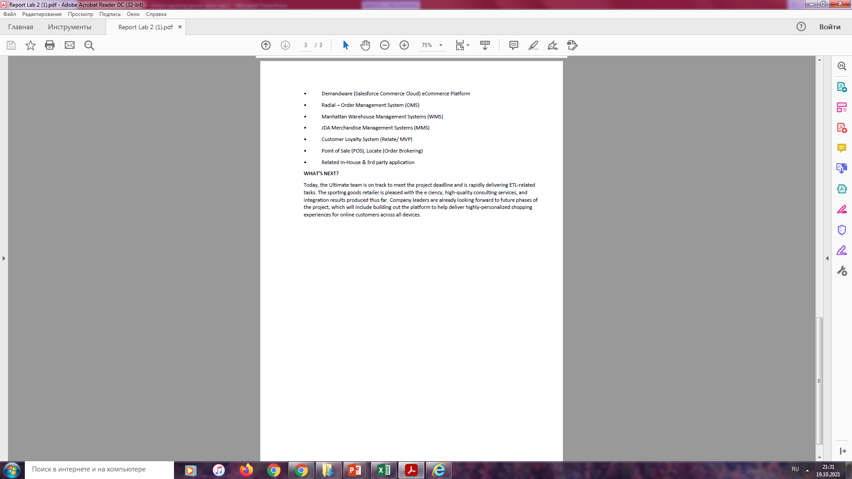
Report

Slide 13
Survey

Slide 14
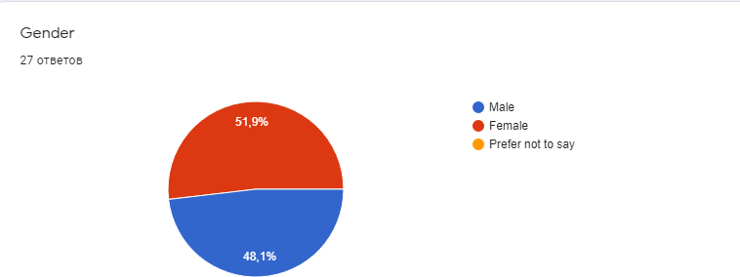
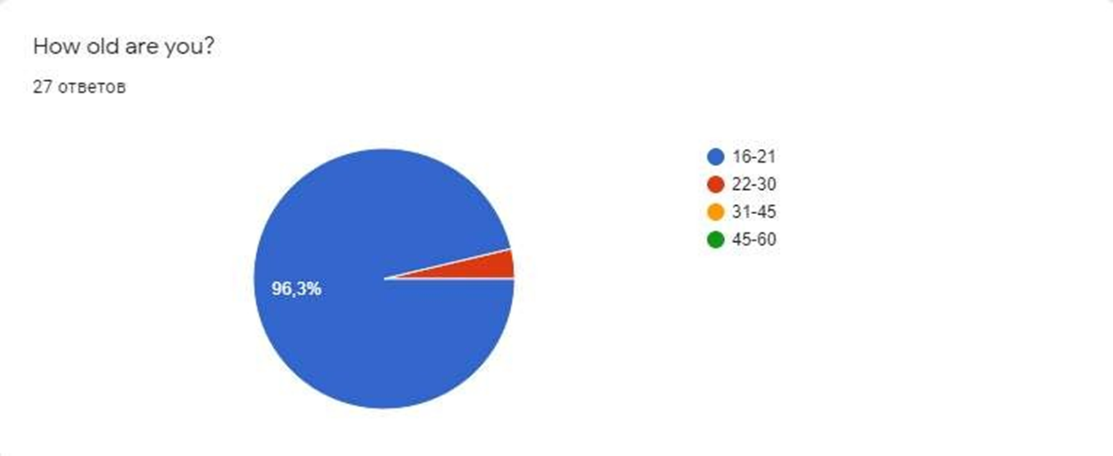
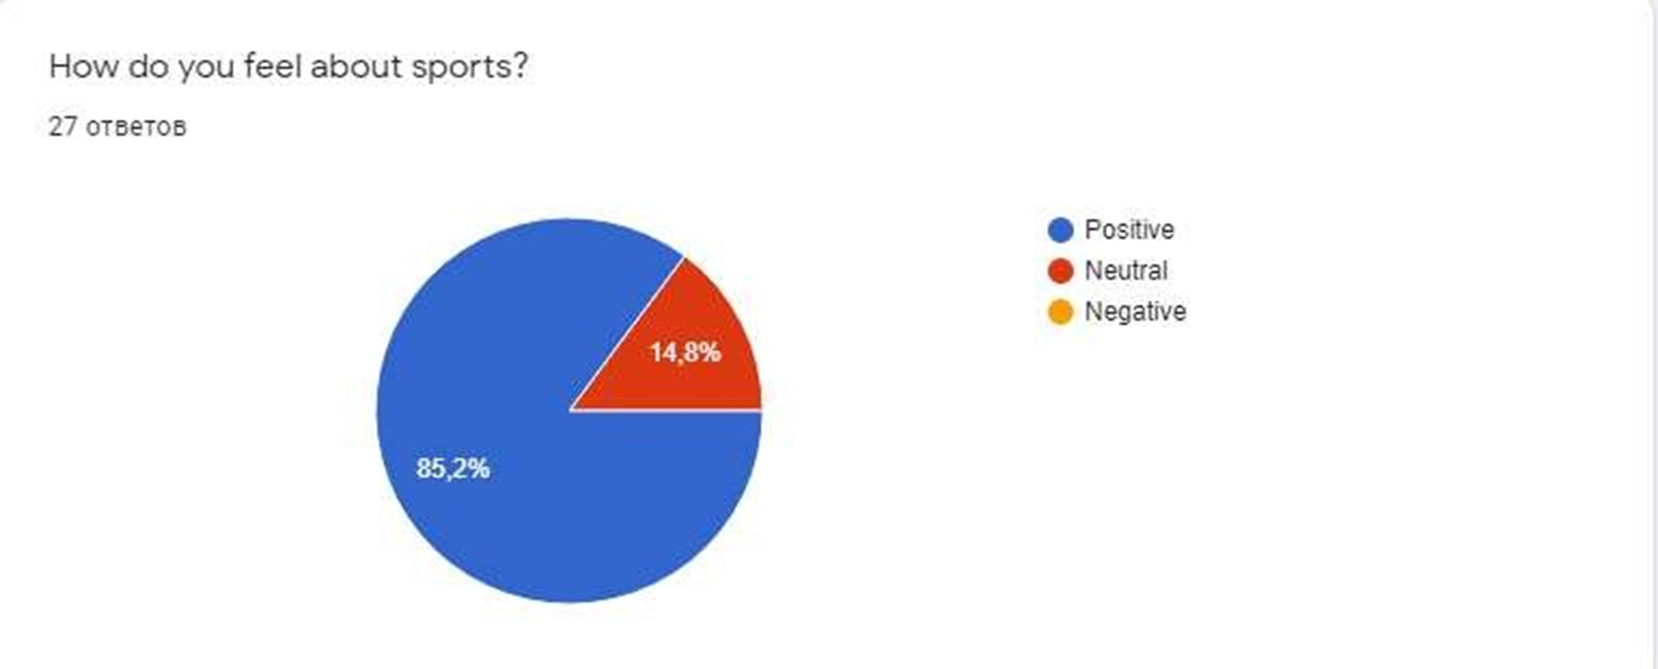
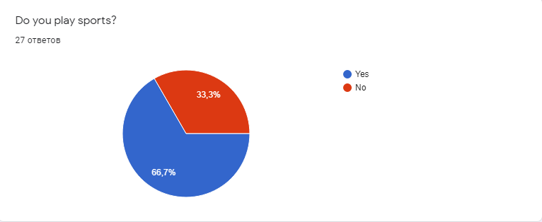
Our project is about an online sports goods store.

Slide 15
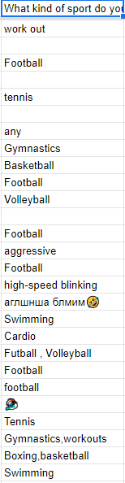
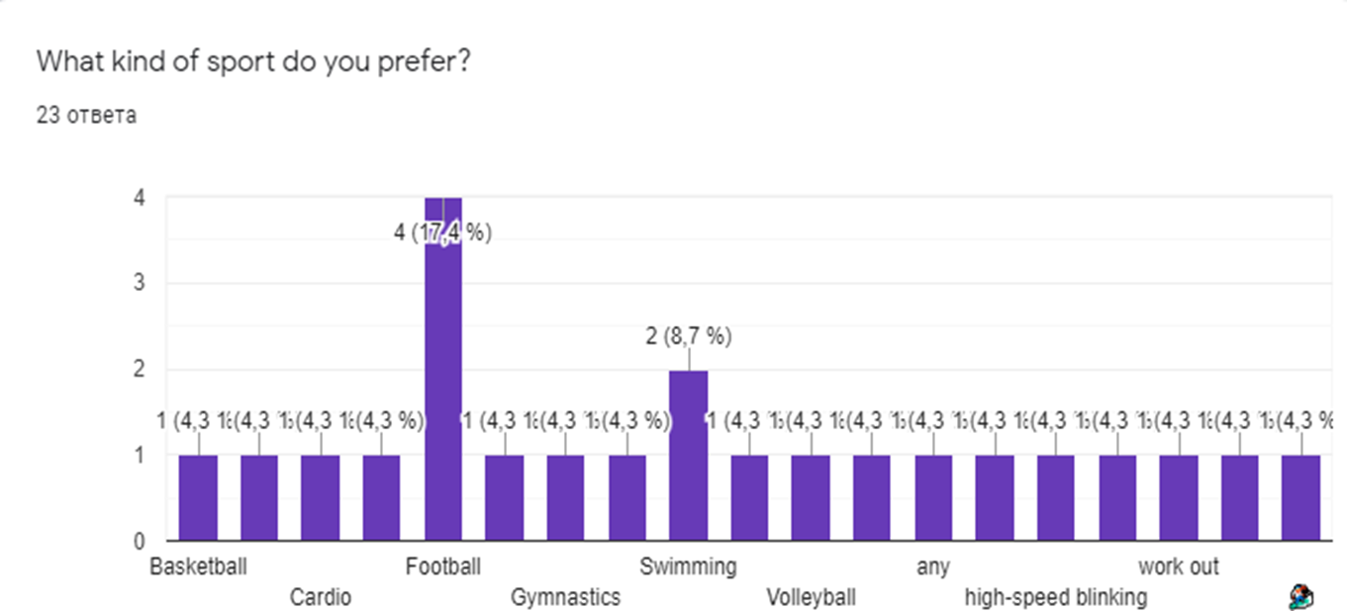

Slide 16
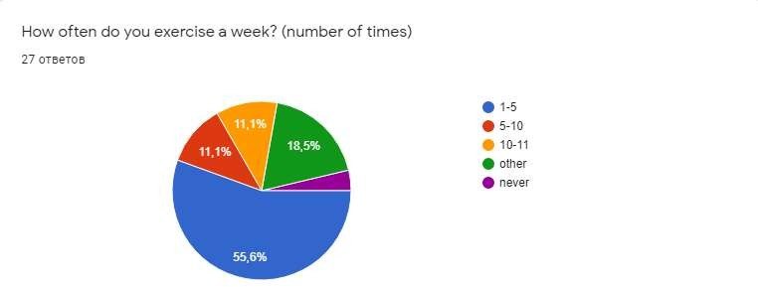
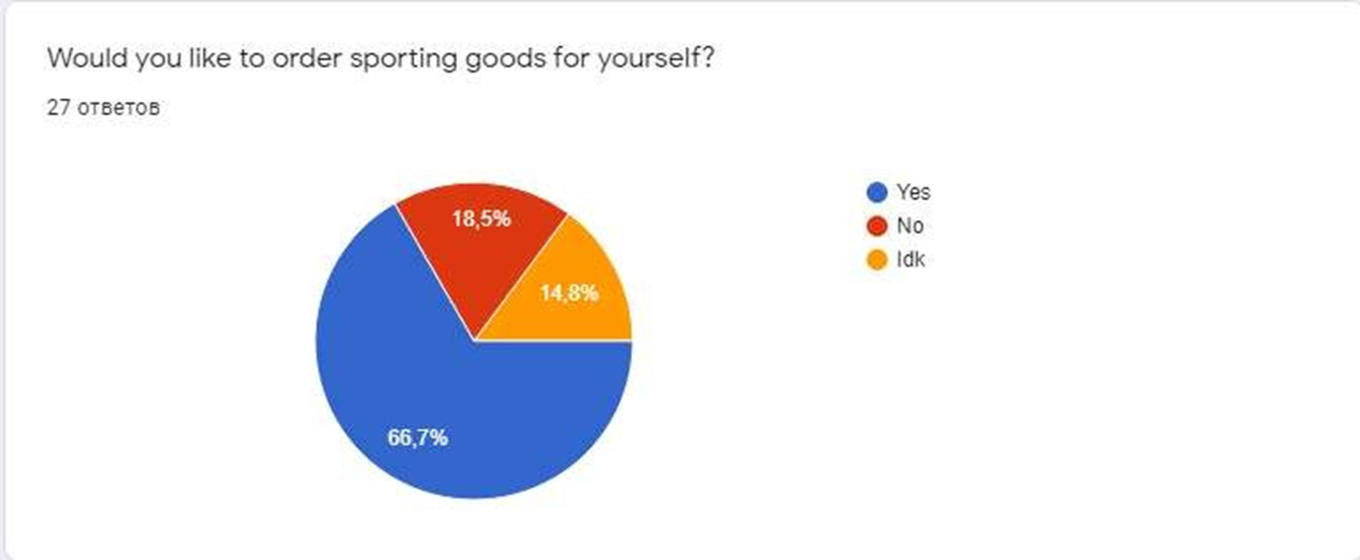

Slide 17
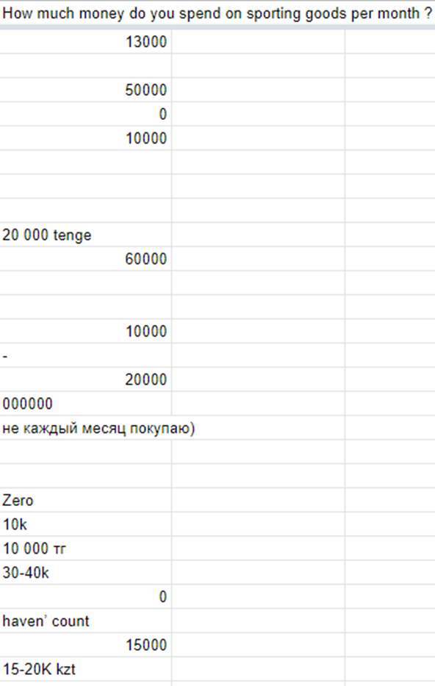
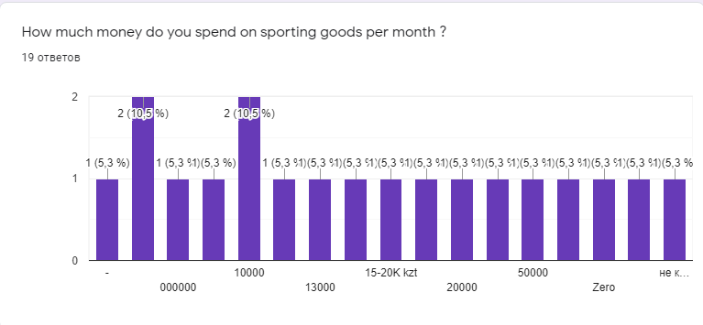

Slide 18
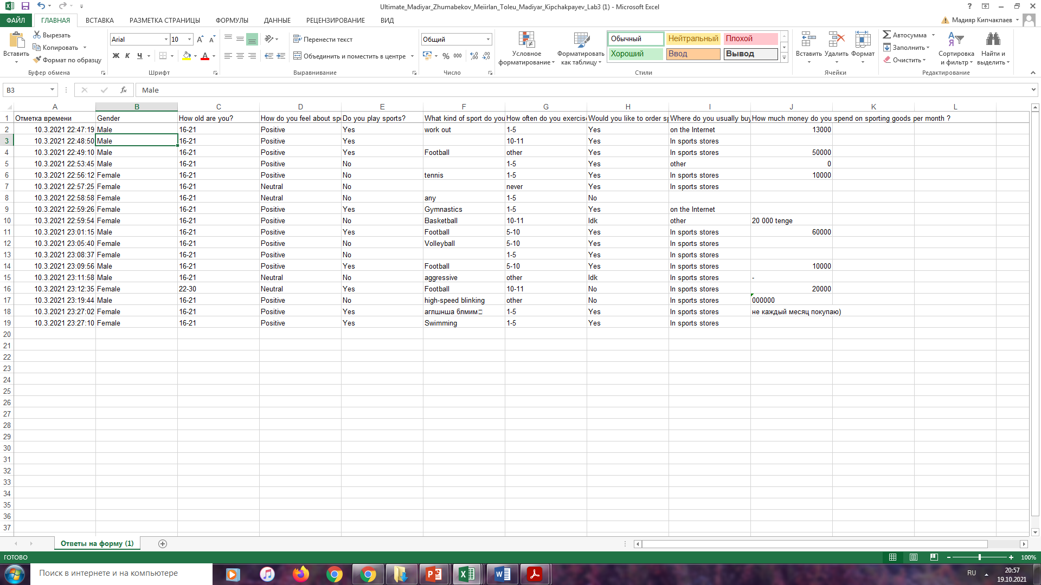

Slide 19
A/B testing

Slide 20
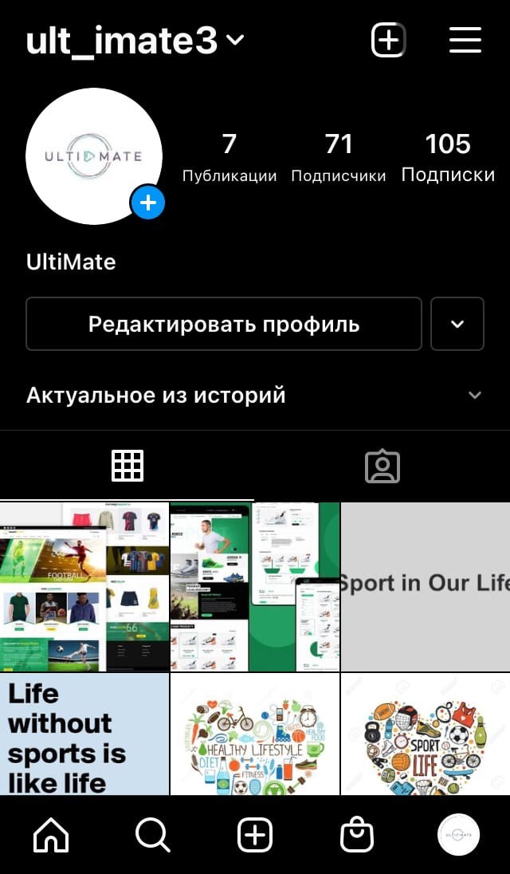
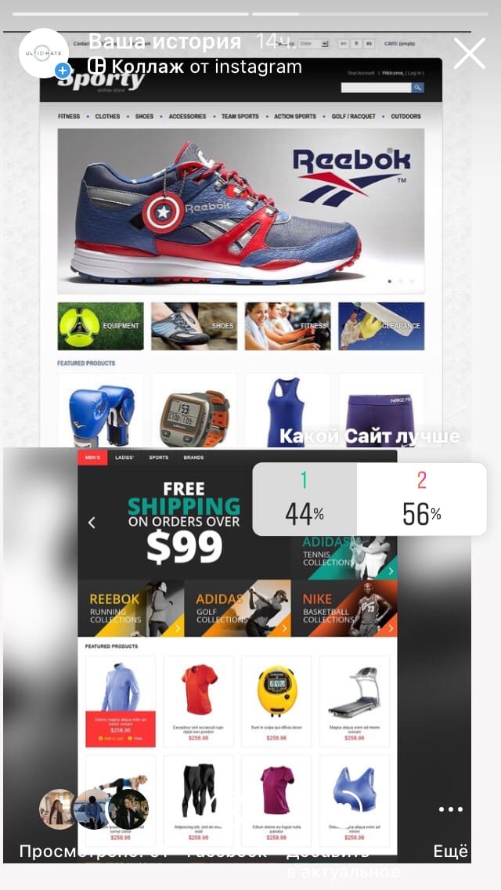
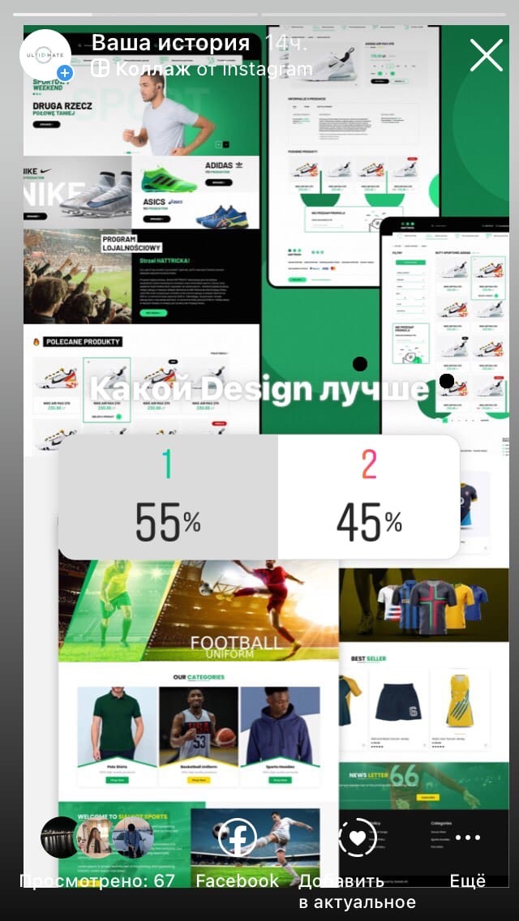
We have posted two versions of the page in the account history. And during the voting, the first option won with 56% (35) of the votes. And the second option received 44% (26) of the votes. Then we compared which design was the best during the vote won the first 55% (36) of the vote. The second option received 45% (31) of the votes. Thus, we learned in which direction to move.

Slide 21
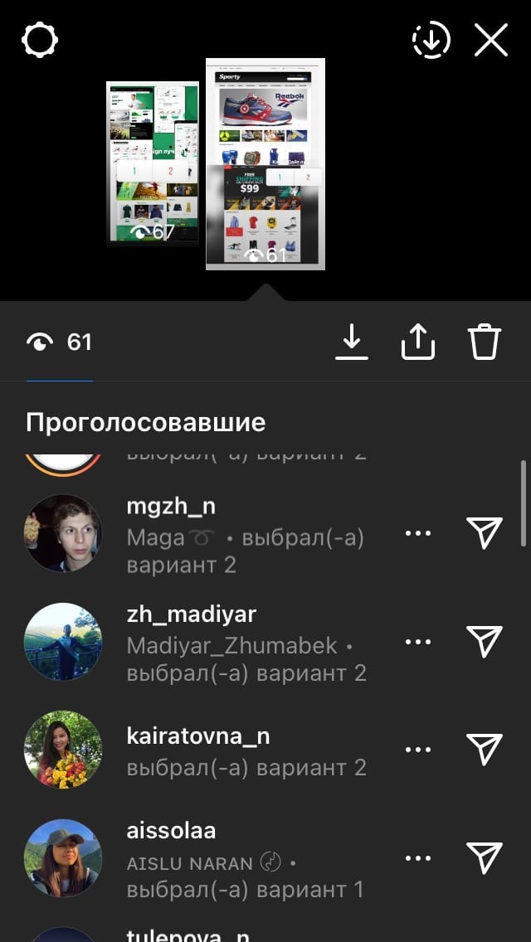
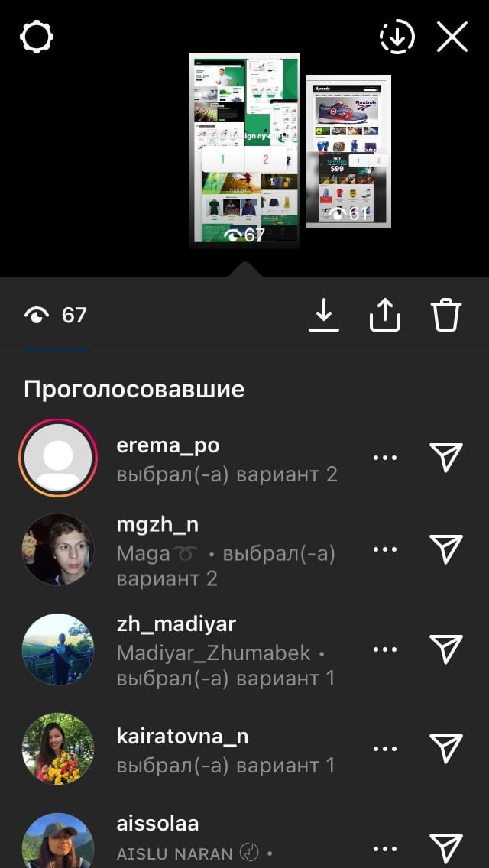
Image 2. Survey results

Slide 22
Roadmap

Slide 23
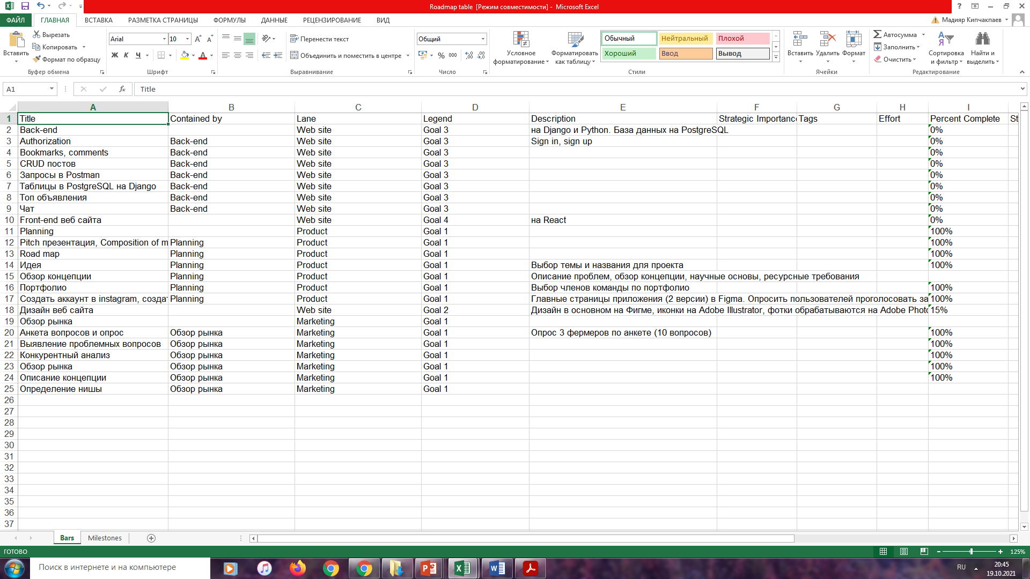

Slide 24
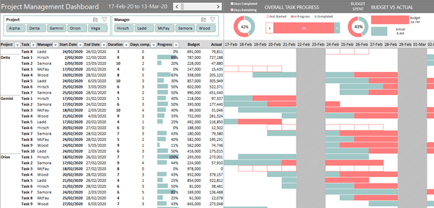
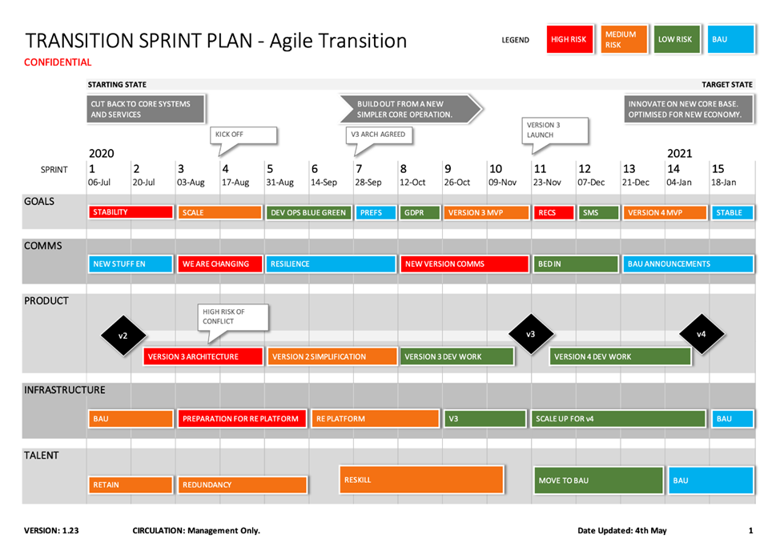

Slide 25
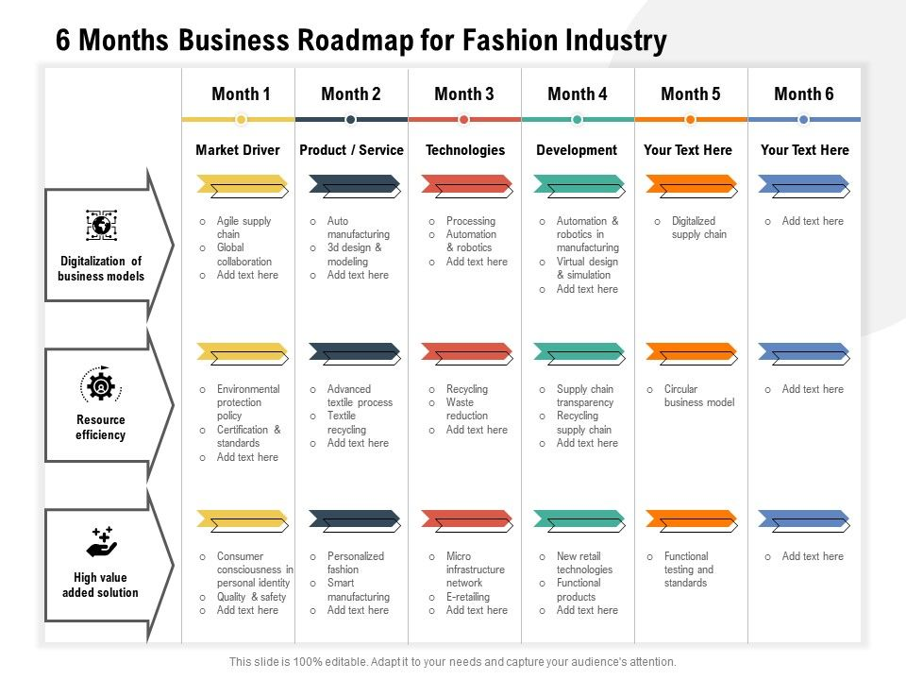
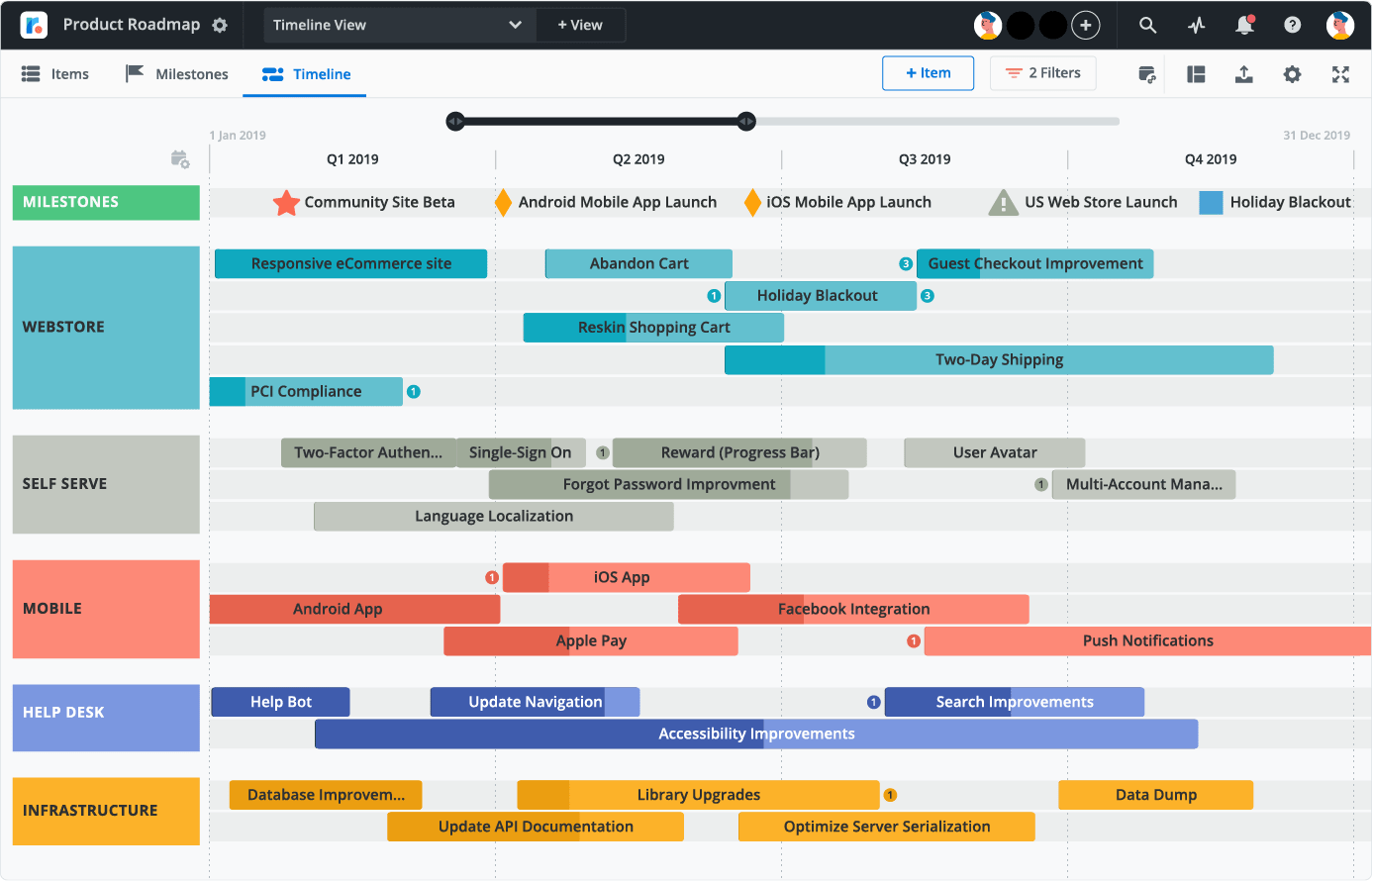

Slide 26
SRS

Slide 27
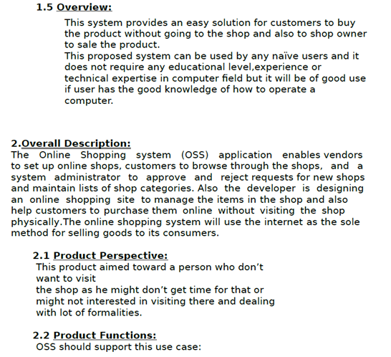
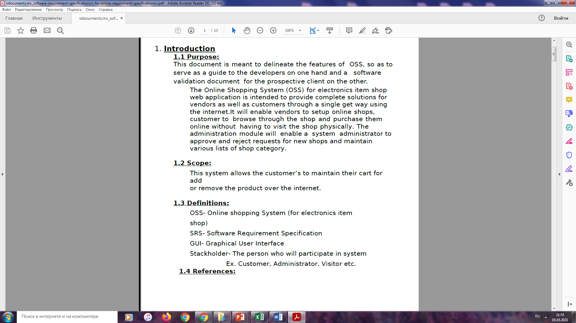
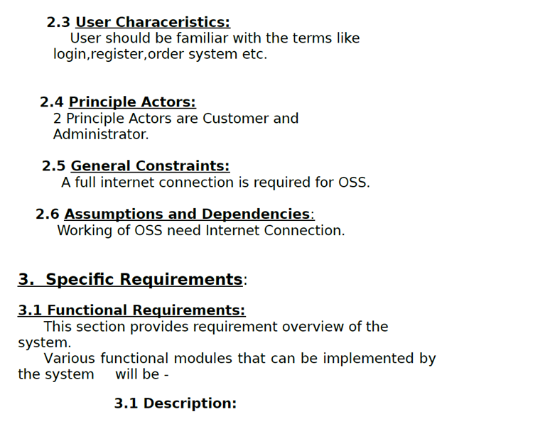

Slide 28
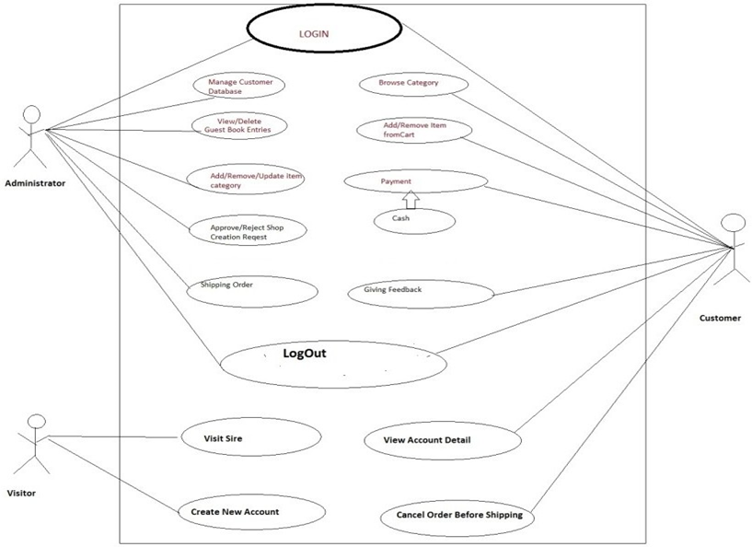
User diagram

Slide 29
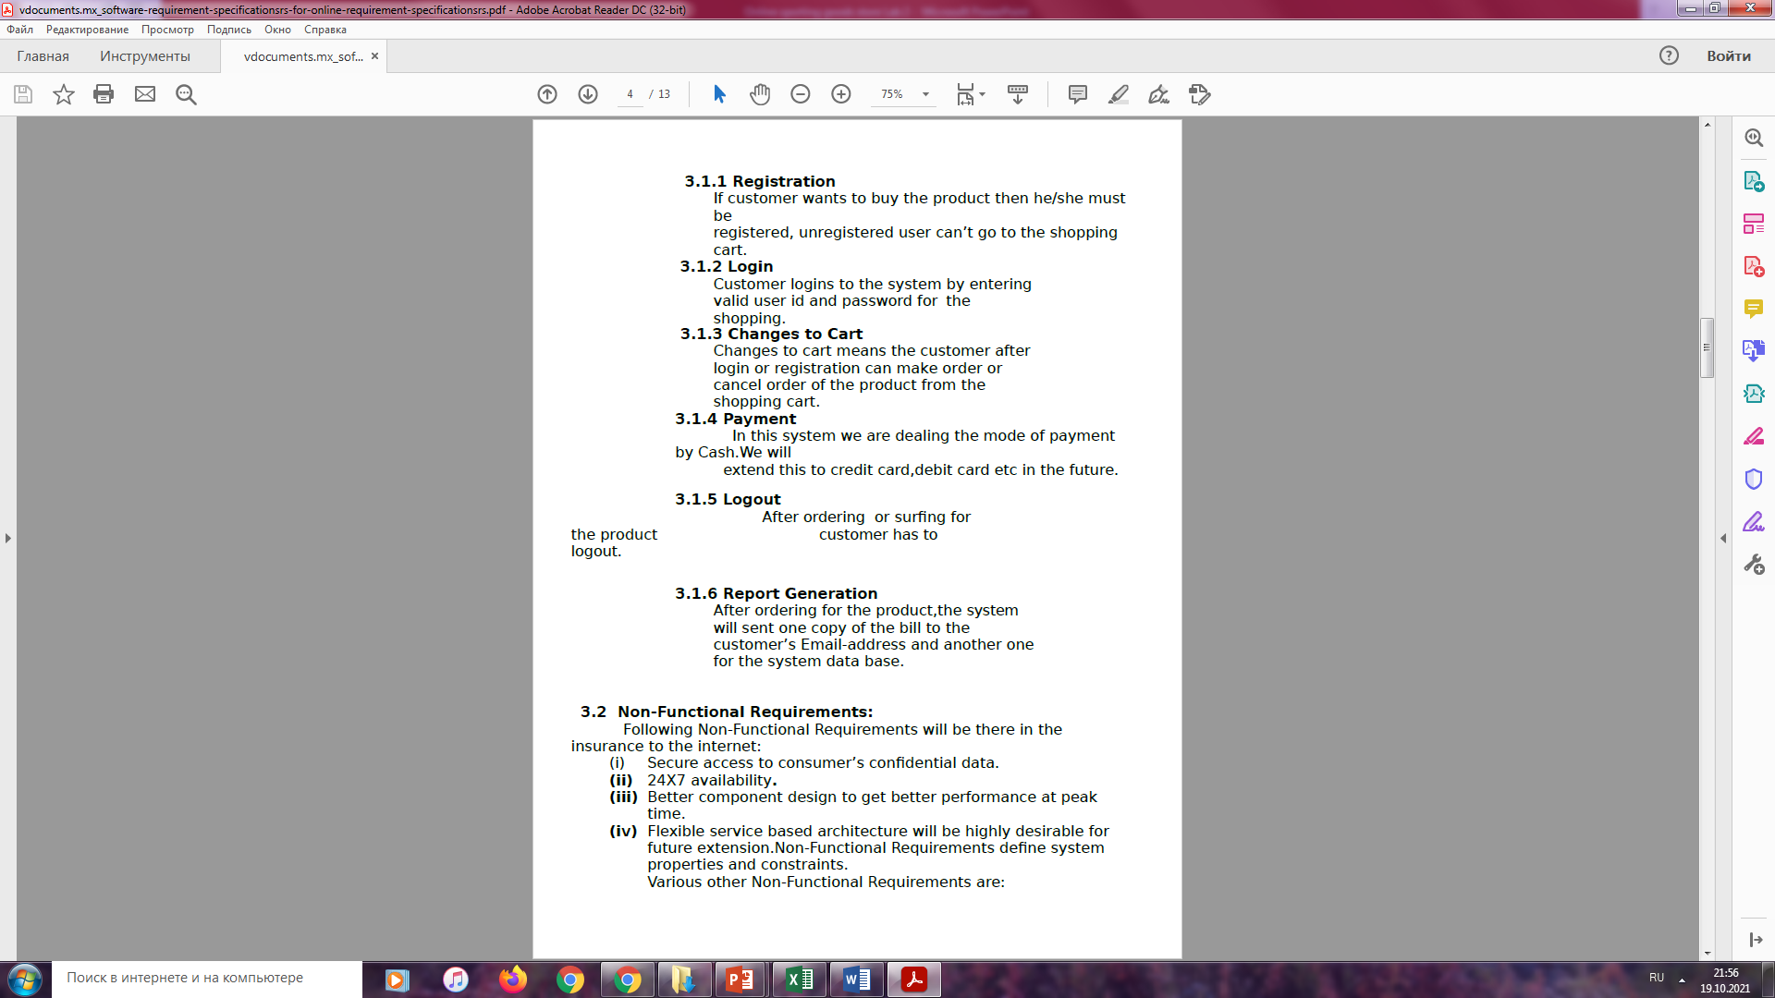
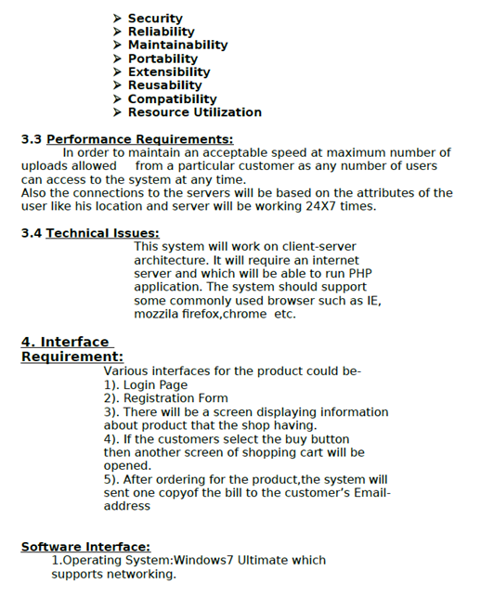

Slide 30
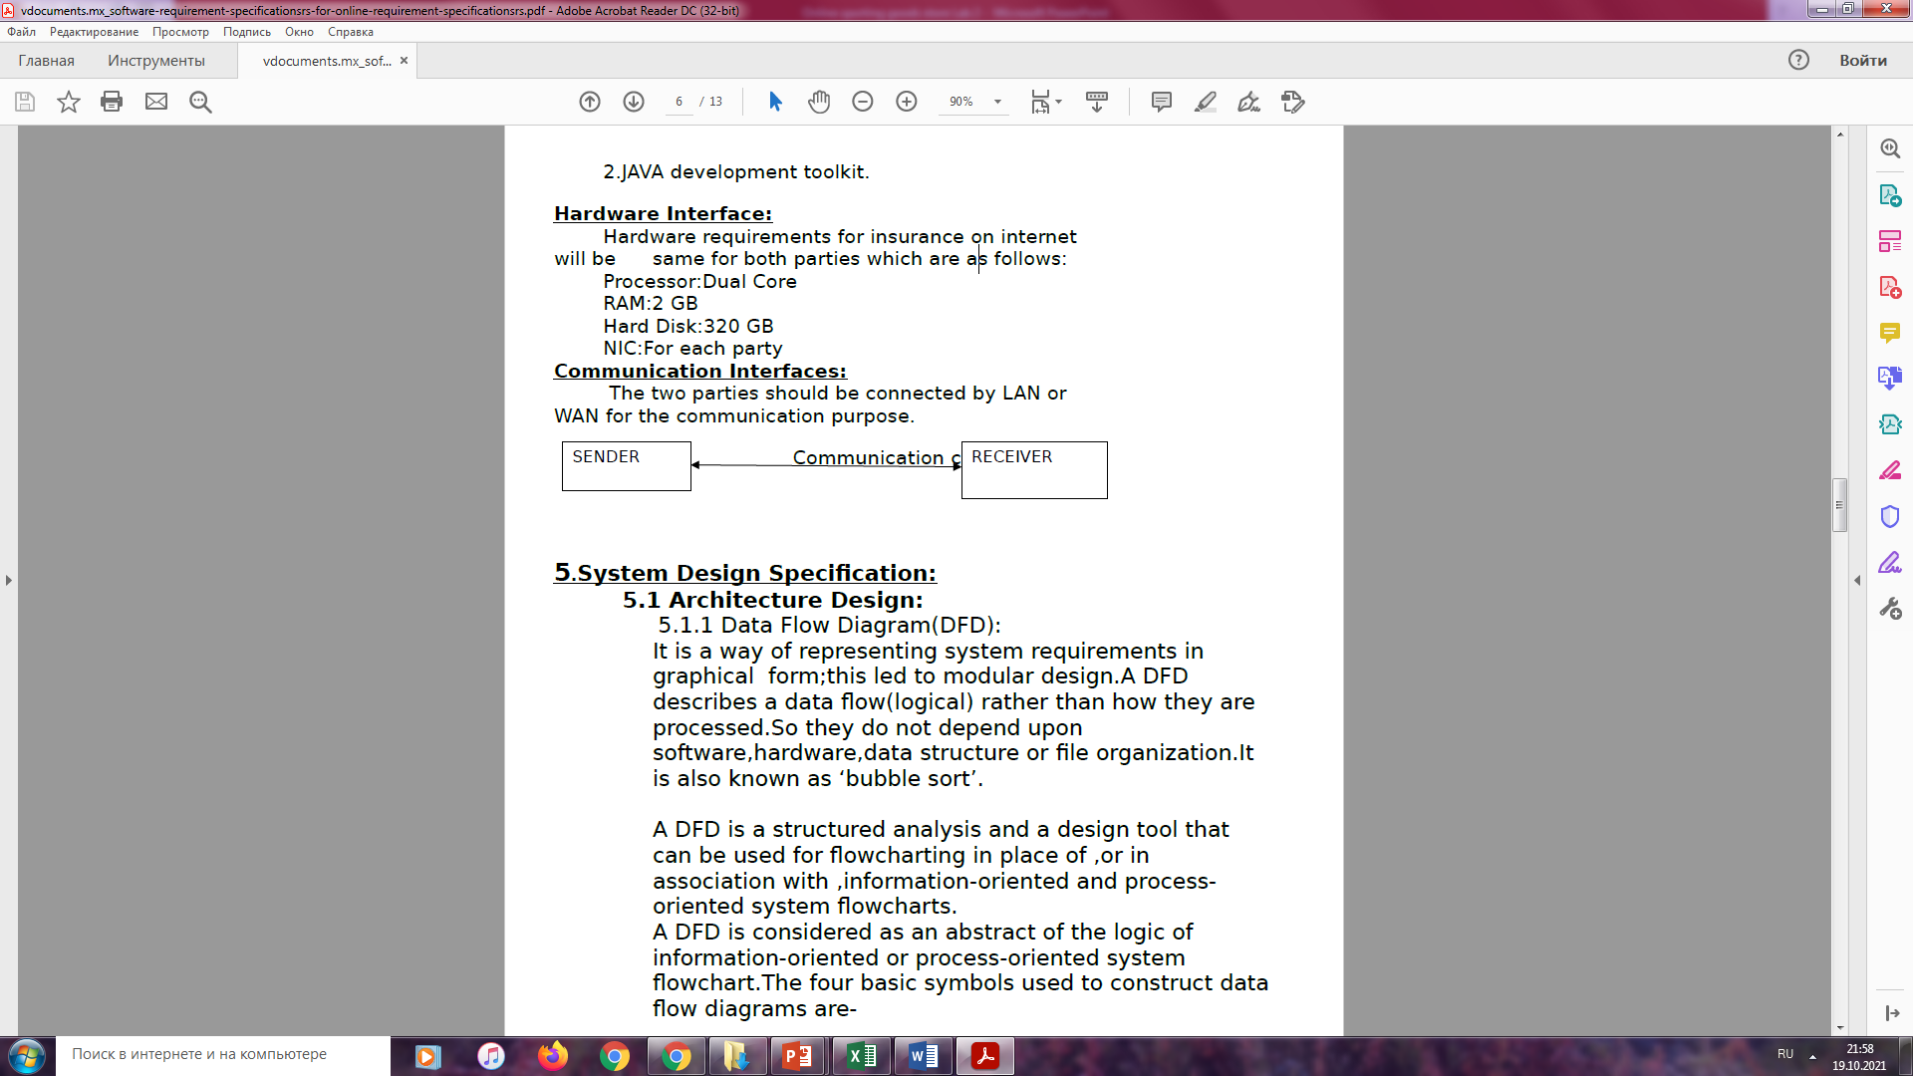
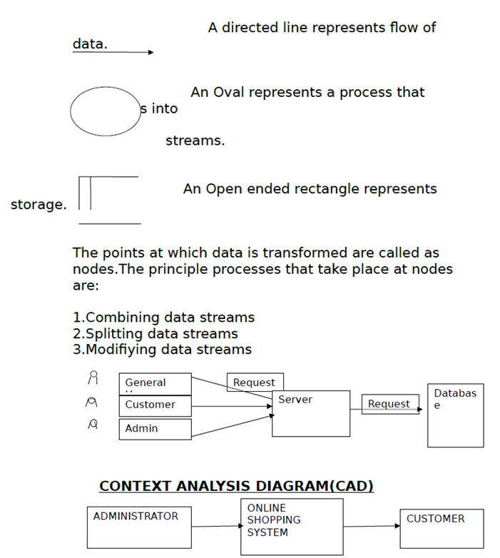
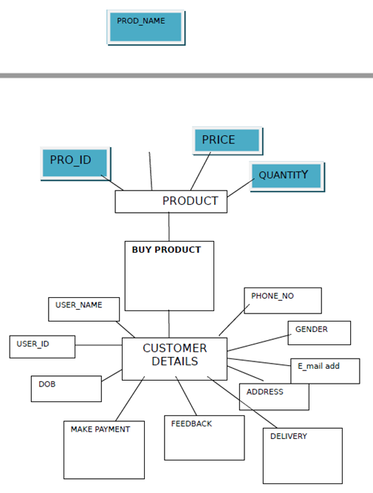

Slide 31
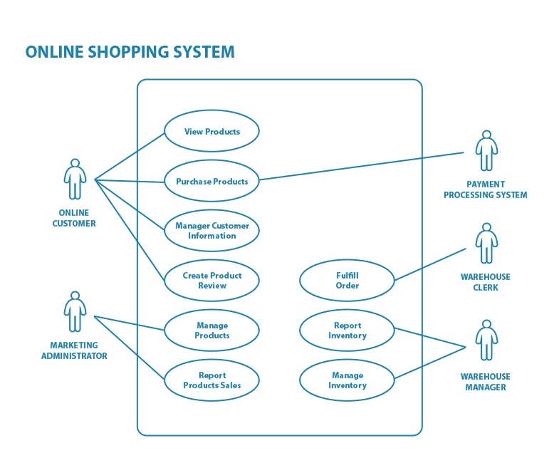
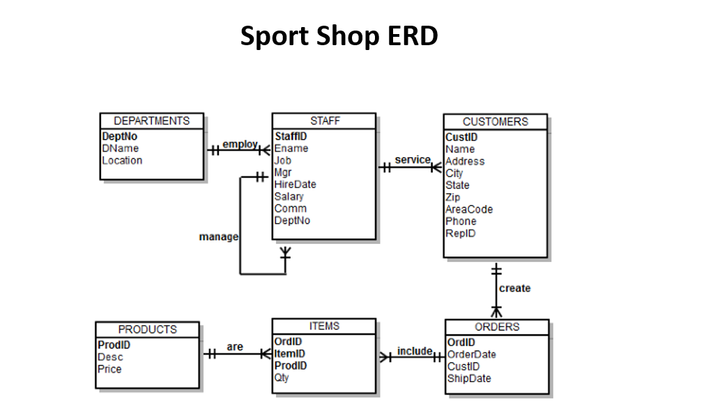

Slide 32
Market research analysis

Slide 33
Nike Swot Analysis
STRENGTHS
A very professionally competitive company
Very well branded among consumers
Offers their product worldwide
Fortune 500 company
Has ventured into many different rebranding opportunities with successful results
WEAKNESSES
Profits are largely dependent on the footwear products while other branded products are not as strong
History of violations of over time laws and minimum wage rates in Vietnam
Accusations of poor conditions in the work place
Accusations of exploiting workforce that will work for cheap in overseas countries
Constant focal point for negative criticism by the antiglobalization groups
OPPORTUNITIES
Creating sports wear items by incorporating the waste from regular manufacturing
Stepping into the line of economy boosting projects that will encourage recycling
Product development that changes as the trends change
Expansion into sport sunglasses and jewelry lines
Reducing controversy surrounding their trade and production practices
THREATS
Operating business internationally opens them to the possibilities of currency value fluctuations that can lead to losses
Competitors are becoming more aggressive and creating high quality products that are taking from the profits of NIKE
Sensitivity to price among consumers leads them to purchase the most cost effective pair of sports shoes
Maintaining the reputation of being eco-friendly
Managing the financial conditions in the economy today

Slide 34
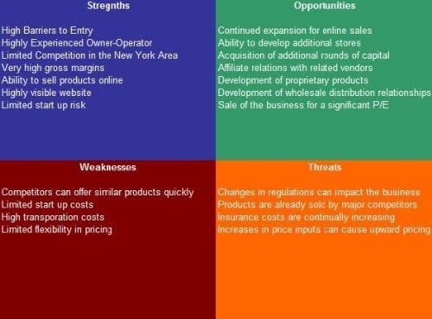

Slide 35
Сomposition of market and GTM

Slide 36
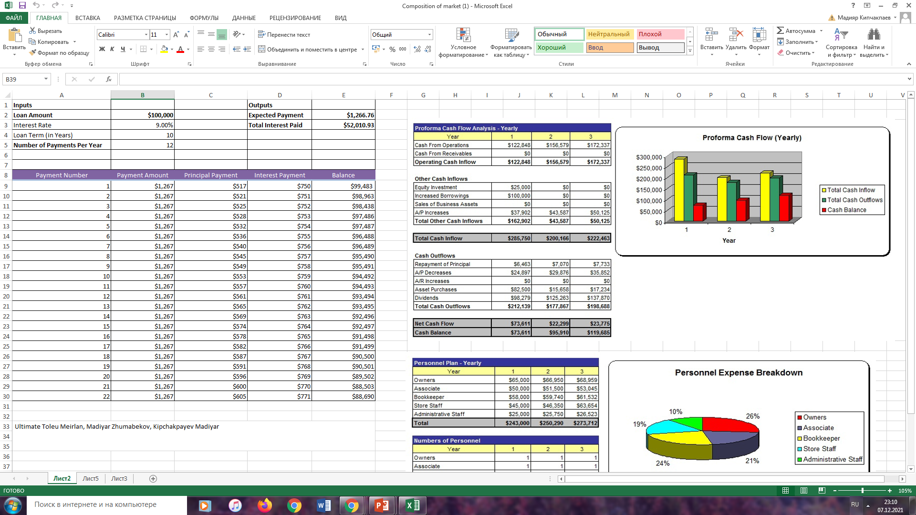
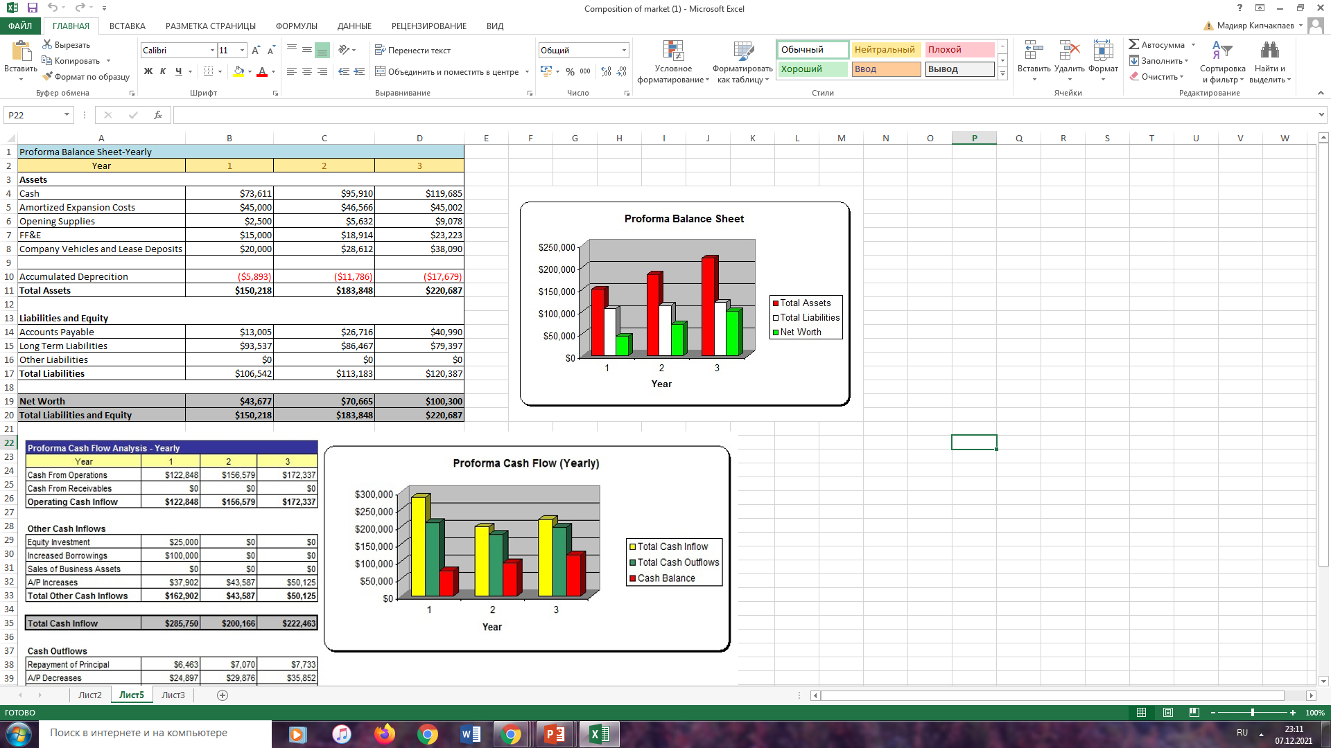
Сomposition

Slide 37
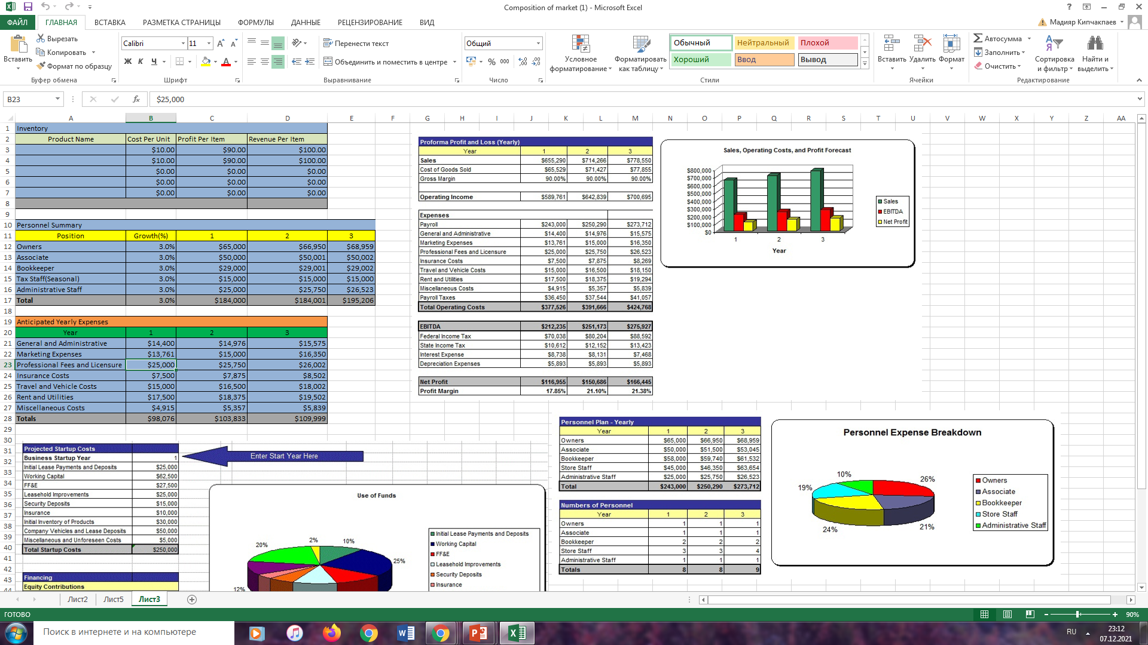

Slide 38
Market and GTM

Slide 39
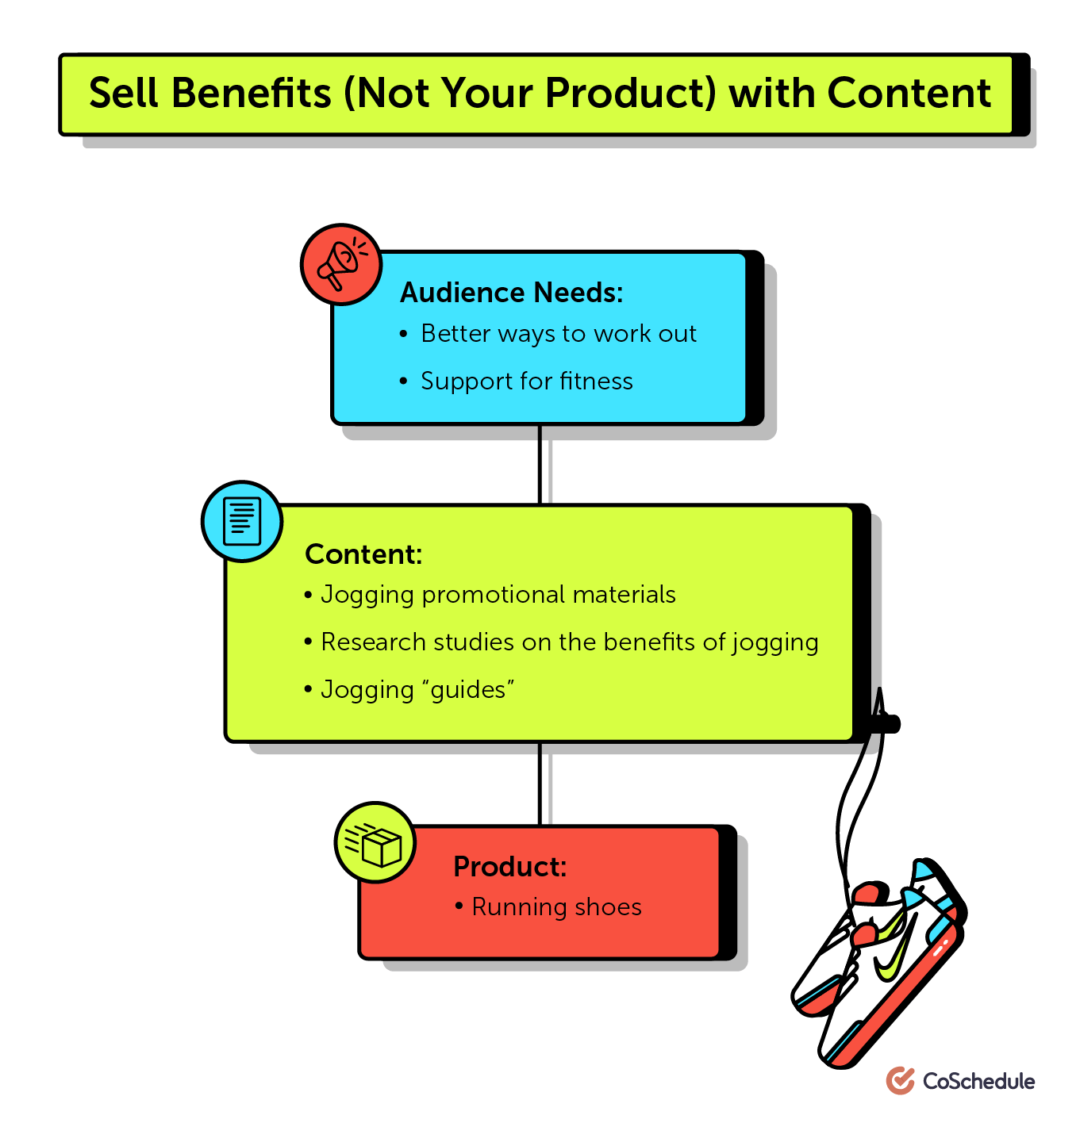
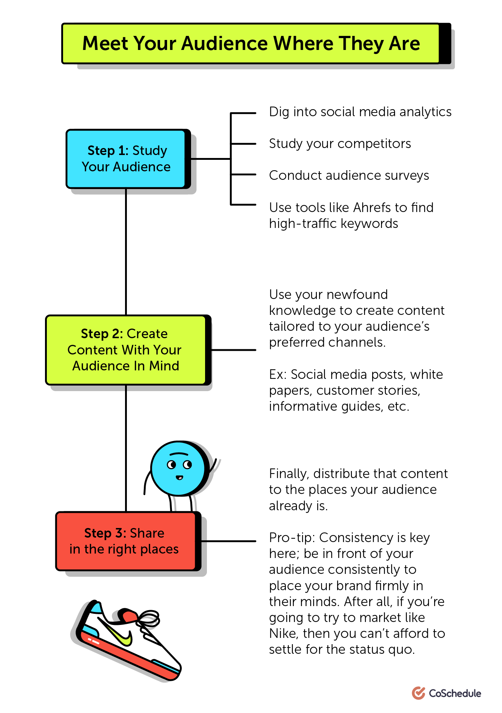
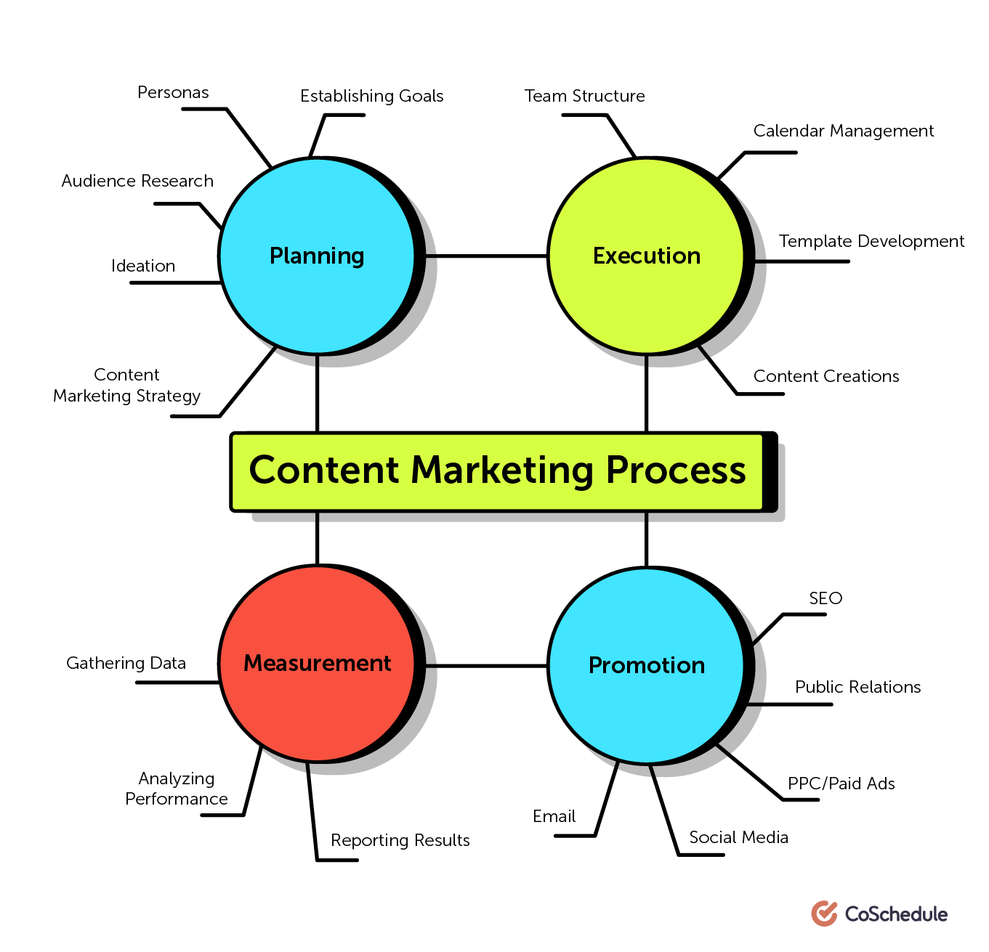

Slide 40
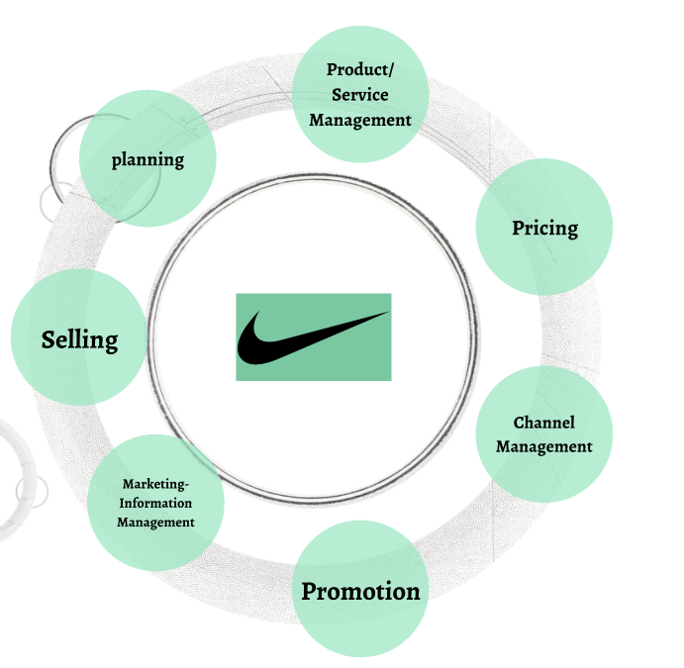

Slide 41
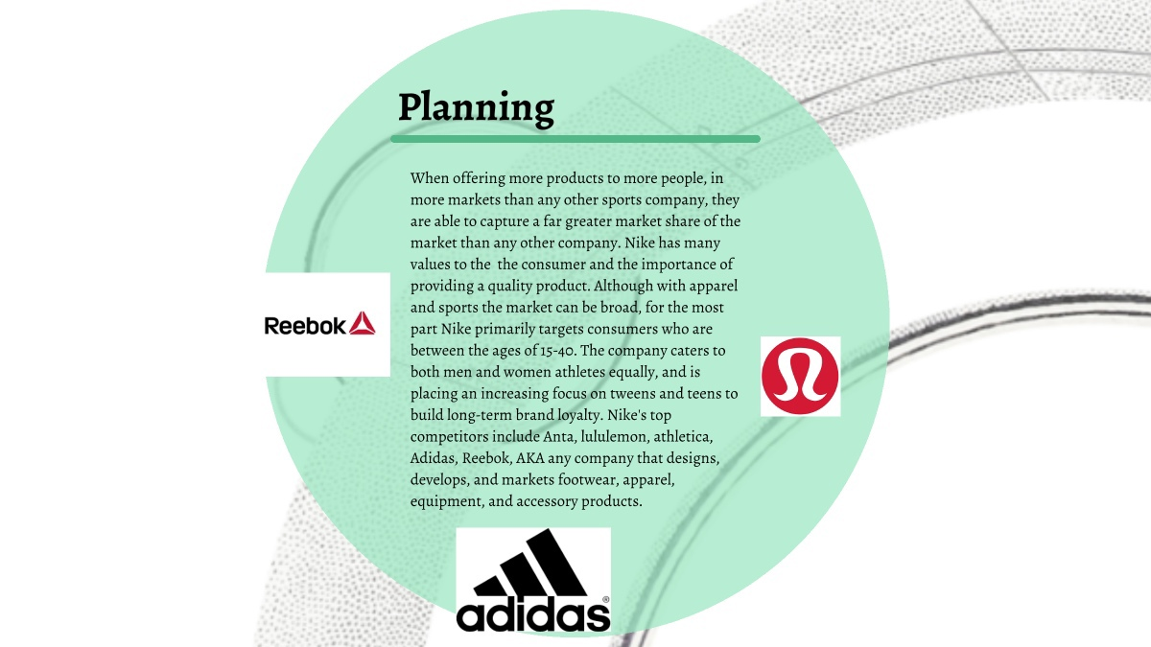
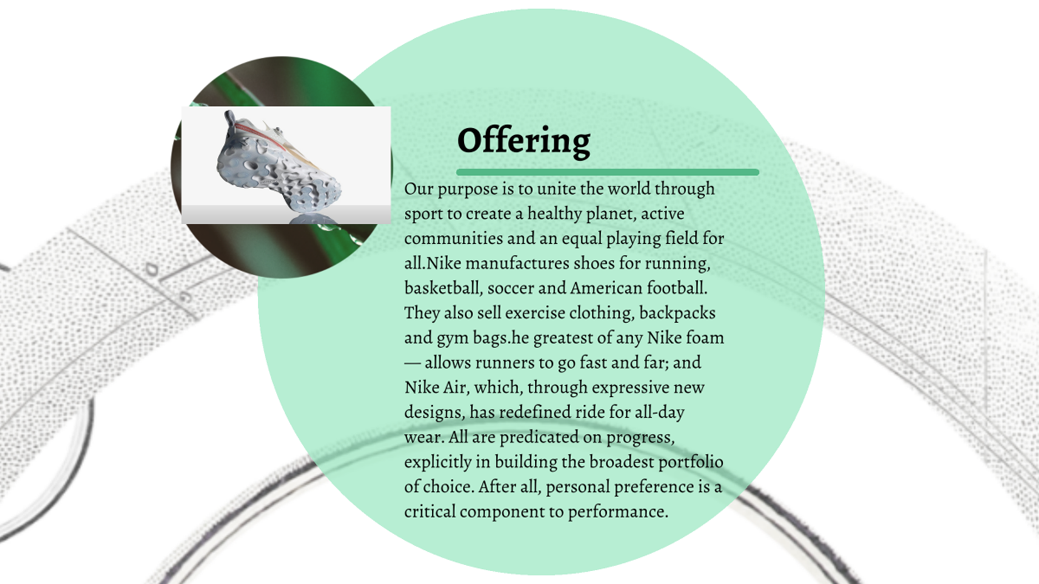

Slide 42


Slide 43


Slide 44


Slide 45


Slide 46


Slide 47


Slide 48
UX research (customer surveys and interviews, fail case)

Slide 49


UX research

Slide 50

The elements analysis helped me get an idea on how I could structure my website prototype but it also displayed that there is no unified correct way of doing it.
Further, I wanted to see what features competitors use on their websites to enhance the experience for their users. I created a large spreadsheet listing all findings after which I summarized the strengths and weaknesses in a table.

Slide 51











Figma https://www.figma.com/file/GpCl4LbcLvwGo2Mk91ME8V/Untitled?node-id=1%3A3545

Slide 52
Figma

Slide 53


